Slide 1
Heat Transfer

Slide 2
Heat Transfer
Heat always moves from a warmer place to a cooler place.
Hot objects in a cooler room will cool to room temperature.
Cold objects in a warmer room will heat up to room temperature.

Slide 3
Question
If a cup of coffee and a red popsickle were left on the table in this room what would happen to them? Why?
The cup of coffee will cool until it reaches room temperature. The popsickle will melt and then the liquid will warm to room temperature.

Slide 4
Heat Transfer Methods
Heat transfers in three ways:
  Conduction
  Convection
  Radiation

Slide 5

Conduction
When you heat a metal strip at one end, the heat travels to the other end.
As you heat the metal, the particles vibrate, these vibrations make the adjacent particles vibrate, and so on and so on, the vibrations are passed along the metal and so is the heat. We call this?
Conduction

Slide 6
Metals are different
The outer e______ of metal atoms drift, and are free to move.
lectrons
When the metal is heated, this ‘sea of electrons’ gain k_____ energy and transfer it throughout the metal.
inetic
Insulators, such as w___ and p____, do not have this ‘sea of electrons’ which is why they do not conduct heat as well as metals.
ood
lastic

Slide 7

Why does metal feel colder than wood, if they are both at the same temperature?
Metal is a conductor, wood is an insulator. Metal conducts the heat away from your hands. Wood does not conduct the heat away from your hands as well as the metal, so the wood feels warmer than the metal.

Slide 8
Convection
What happens to the particles in a liquid or a gas when you heat them?
The particles spread out and become less dense.
This effects fluid movement.
What is a fluid?
A liquid or gas.

Slide 9
Fluid movement
Cooler, more d____, fluids sink through w_____, less dense fluids.
ense
armer
In effect, warmer liquids and gases r___ up.
ise
Cooler liquids and gases s___.
ink

Slide 10
Water movement
Cools at the surface
Convection current
Cooler water sinks
Hot water rises

Slide 11
Why is it windy at the seaside?

Slide 12
Cold air sinks
Where is the freezer compartment put in a fridge?
Freezer compartment
It is warmer at the bottom, so this warmer air rises and a convection current is set up.
It is put at the top, because cool air sinks, so it cools the food on the way down.

Slide 13
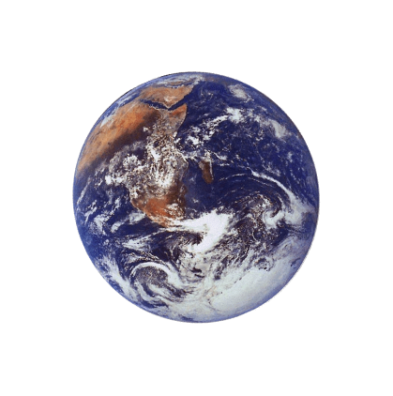
The third method of heat transfer
How does heat energy get from the Sun to the Earth?
There are no particles between the Sun and the Earth so it CANNOT travel by conduction or by convection.
RADIATION
?

Slide 14
Radiation
Radiation travels in straight lines
True/False
Radiation can travel through a vacuum
True/False
Radiation requires particles to travel
True/False
Radiation travels at the speed of light
True/False

Slide 15
Emission experiment
Four containers were filled with warm water. Which container would have the warmest water after ten minutes?
Dull metal
Shiny black
Shiny metal
Dull black
shiny metal
The __________ container would be the warmest after ten minutes because its shiny surface reflects heat _______ back into the container so less is lost. The ________ container would be the coolest because it is the best at _______ heat radiation.
radiation
dull black
emitting

