Slide 1
Drilling Fluid and Cementing Technology

Slide 2
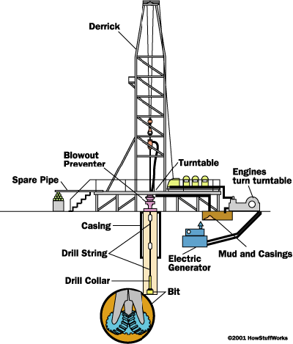
Oil & Gas drilling

Slide 3
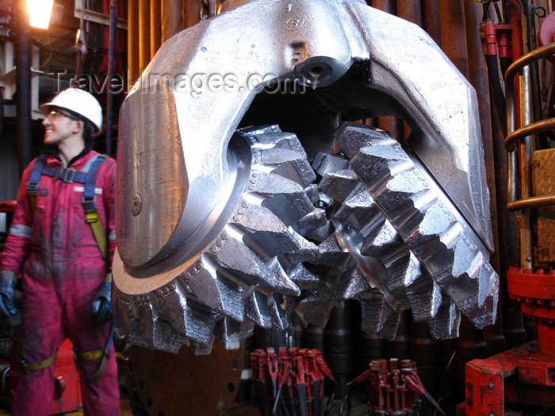
The BIT
Rotary drill bit designed to crush rock
Carbide or diamond impregnated steel

Slide 4
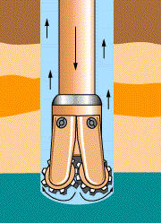
Drilling Mud
Crushed rock has to get out of the hole, also the hole must be supported – use drilling mud to do both
Can use air, water, water with additives (clays, chemicals to affect viscosity and heat transfer), oil, and synthetic fluids

Slide 5
Drill String
Combined term for the bit, the drill stem (hollow, turns the bit and pushes fluid down), annulus (outside the stem where the mud comes up), and drill collar (weight to ‘push’ bit down into the rock)

Slide 6
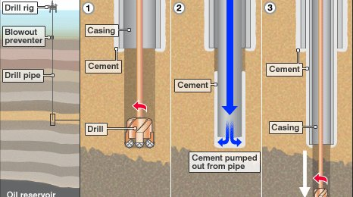
Well casing
Casing is the tube (often steel) that is sealed to the borehole with cement – prevents leakage (in or out) and strengthens the hole

Slide 7
Derrick / Platform
Working area for all drill operations, on land or at sea, engines, equipment, casing and string storage
Derrick is the part sticking up that feeds casing/string down the borehole
Also contains the machines for turning the drill string and bit, injecting and collecting the mud

Slide 8
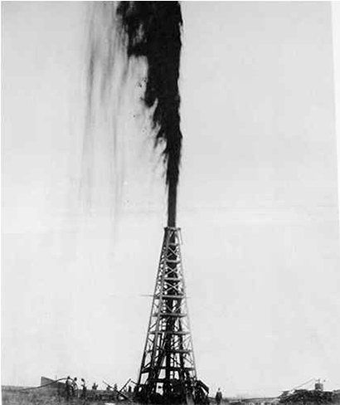
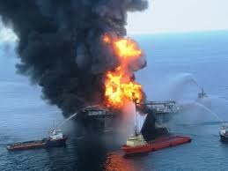
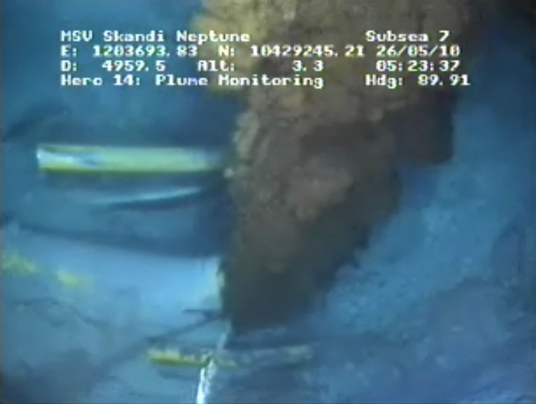
Striking Oil
What happens when the bit finally breaks through the capping formation and into the reservoir rock at an oil & gas trap?

Slide 9
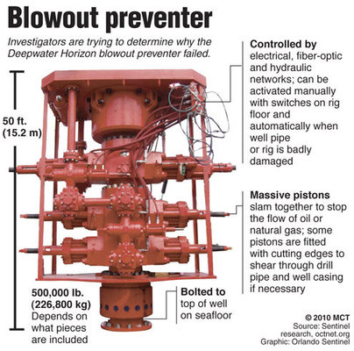
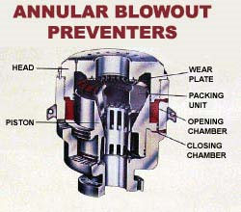
Blowout preventer
Device to control and stop erratic pressures and prevent a blowout

