Slide 1
Fluid Solid Operations

Slide 2
THEORY
OPERATION
DESIGN

Slide 3
THEORY
Also referred as ‘SEDIMENTATION TANKS’.
Settling- process by which particulates settle to the bottom of a liquid and form a sediment.
Particles experience a force, either due to gravity or due to centrifugal motion; tend to move in a uniform manner in the direction exerted by that force.
Gravity settling- the particles will tend to fall to the bottom of the vessel, forming a slurry at the vessel base.
For dilute particle solutions, two main forces enacting upon particle. Primary force is an applied force, such as gravity, and a drag force that is due to the motion of the particle through the fluid. The applied force is not affected by the particle's velocity; the drag force is a function of the particle velocity.

Slide 4
Settling or Sedimentation
Settling- a unit operation in which solids are drawn toward a source of attraction. The particular type of settling that will be discussed in this section is gravitational settling. It should be noted that settling is different from sedimentation.
Sedimentation- The condition whereby the solids are already at the bottom and in the process of sedimenting. Settling is not yet sedimenting, but the particles are falling down the water column in response to gravity. Of course, as soon as the solids reach the bottom, they begin sedimenting. In the physical treatment of water and wastewater, settling is normally carried out in settling or sedimentation basins.

Slide 5
Removal Mechanisms
    Gravity separation
      Settling tanks, tube settlers and hydro cyclones
    Filtration
      Screen, Granular media, or porous media filter
    Flotation
      Foam Fractionation
Notes:
The treatment processes and system strategies should remove solids rapidly before they degrade, with the least turbulence, shear or opportunity for microbial degradation.
There are three methods that are used to remove suspended solids from fish culture waters. These are:
gravity separation
filtration
flotation
These classifications of methodology are based on the removal mechanisms used to effect the removal (flotation is sometimes considered as another kind of gravity separation, but it is a different principle of application so it is described separately). Large particles (larger than 100 μm) can be effectively removed by settling basins or mechanical screen filtration. However, fine particles cannot be removed effectively by either gravity separation or granular filtration methods. Granular filters are effective only in the removal of particles larger than 20 μm.
Gravity Separation. Gravity separation works on the principle of sedimentation and settling velocities. Unit processes in this category include clarifiers (settling tanks), tube settlers, and hydrocyclones.
Filtration Removal. Particle removal from the water can be accomplished by one or more filtration processes. These are sedimentation, straining, Brownian diffusion, and interception. These processes are implemented in filtration systems by screen, granular media (GM), or porous media (PM) filters.
Flotation Process. In a flotation process, particles attach onto air bubbles and are separated from water. The flotation process involves all the transport mechanisms that occur in a filtration process with the exception of straining.

Slide 6
Settling Basins
Advantages
Simplest technologies
Little energy input
Relatively inexpensive to install and operate
No specialized operational skills
Easily incorporated into new or existing facilities
Disadvantages
Low hydraulic loading rates
Poor removal of small suspended solids
Large floor space requirements
Re-suspension of solids and leeching
Notes:
Settling basins are very effective if properly configured and operated. Sedimentation, i.e., gravity separation, is one of the simplest of technologies available to control particulate solids in process water and wastewater. Sedimentation basins require little energy input, are relatively inexpensive to install and operate, require no specialized operational skills, and can be easily incorporated into both new and existing facilities.
The disadvantages of sedimentation are low hydraulic loading rates and poor removal efficiency of small suspended solids (<100 μm). Also, they require additional floor space for their incorporation in comparison to microscreen filters. Innovative uses of vertical space over the settling bed or placing the settling bed in less expensive space can reduce this cost considerably.
Another potentially serious disadvantage is that settled manure remains in the system until the settling basin is cleaned. This condition is one of the major concerns in their use. Dissolution of nutrients and the resuspension of solids that have settled and collected on the bottom of settling basins can markedly reduce the expected performance of these clarifiers (Cripps and Kelly, 1996). Henderson and Bromage (1988) estimated that settling ponds could capture an estimated 97% of their solids loading if resuspension of settled solids was not a factor. They suggest that settling basins are not effective in removing TSS when inlet concentrations are <10 mg/L or attaining effluent concentrations of <6 mg/L. Eliminating resuspension of TSS is difficult at best in most settling basins. Thus, settling basins will generally require further TSS treatment to meet the stringent removal criteria necessary to achieve mandated levels of TSS.

Slide 7
Solids Physical Characteristics
    particle specific gravity
    particle size distribution
Two most important physical characteristics of suspended solids:
Notes:
From the perspective of solids control, the two most important physical characteristics of suspended solids in a recirculating system are:
particle specific gravity
particle size distribution
Specific gravity is determined by the source of the particles, while the size distribution is determined by a combination of factors, including the solids removal process, the source of particles, fish size, water temperature, and turbulence in the system.
The behavior of suspended particles in water is determined by the specific gravity of the particles. Specific gravity is defined as the ratio of the density of a wet particle to that of water (APHA, 1989). Fish feces is not much "heavier" than water and therefore does not settle as rapidly as would aggregate material of the same size.
While feces is the source of most of the suspended solids, uneaten feed is also a significant source of TSS in fish culture water. TSS from feed typically has a different particle size distribution than the TSS originating as feces. Uneaten feed subsequently breaks down slightly in the water column, but even after several hours and repeated passage through pumps, over 97% of the feed particles will be greater than 60 μm in size and 73% will be larger than 500 μm (0.5 mm). The particles of suspended solids originating from these two sources (feces and uneaten feed) are notably different in size and specific gravity and therefore respond to control mechanisms in different ways. In RAS waters, fine particles (particles less than 30 μm) are the most prevalent and dominate the water column. In water reuse systems (the focus of this book), fine particles (particles less than 30 μm) will dominate the water column.
Sedimentation techniques will not remove the fine particles from the water. This is because fine particles (<30 μm) have low settling velocities that make gravitational removal methods impractical. For example, fine particles need a retention time of several hours to settle a distance of 0.5 m. Sedimentation tanks are often regarded as being inefficient, but this opinion is usually caused by the settlement characteristics of fine particles, which require a lengthy retention time to settle or because the sedimentation tank(s) were simply poorly designed to begin with.

Slide 8
DESIGN
In specifying a water and wastewater sedimentation tank size, the major features to be considered are:
- tank cross sectional area,
- tank depth,
and type of cleaning mechanism used.
In specifying a design basis for water and wastewater sedimentation tanks; three conditions are commonly considered:
- solid handling capacity (kg/day),
overflow rate (lpm/m2),
detention time.
Additional design data required to ascertain mechanical construction, specific gravity of solids, size distribution of solids, underflow construction, operating temperature, and geographical location. Typical dimensions of sedimentation tanks are given in Table 1.

Slide 9
Sedimentation
Stokes Law
Denser and large particles have a higher settling velocity
Notes:
Sedimentation occurs due to the density difference between the solid particles and water. Assuming a particle to be heavier than water, under the force of gravity it will fall through the water with increasing speed until it reaches a terminal value for its settling velocity. Each discrete particle has an equilibrium settling velocity.
For a small particle having a low Reynolds number, Stoke's Law applies and the settling velocity can be described as shown above. This equation indicates that denser and larger particles will settle out of water faster than smaller, less dense particles. This is true for all types of removal processes and why you should do everything possible to maintain large particle sizes. The best technique for maintaining large particle sizes is to remove the particles as quickly as possible from the fish culture vessel and before any pumping has occurred. Also, you should try to minimize any turbulence/falling water situations prior to the primary TSS capture event.

Slide 10

Settling Basins
Design to minimize turbulence:
length:width = 4:1 to 8:1
inlet
outlet
effective settling zone
1–2 m
sludge zone
chamfered weir
to enhance laminar flow
(85% of water depth)
full-width
weir
Notes:
All continuous flow settling basins are conceptually divided into four zones according to function, see above. The inlet zone serves to uniformly distribute the suspension over the entire cross-section of the basin. Sedimentation occurs in the settling zone and, upon removal from the water column, the solids accumulate in the sludge zone. The clarified liquid is generally collected over the entire cross-section of the basin at the outlet zone and is discharged. Under ideal conditions (no mixing or turbulence), required retention time is the time required for a particle that starts at the top of the inlet zone and settles to the floor of the basin at or before the junction of the outlet zone. The key parameter for the design of settling basins is the volumetric flow of water per unit surface area of the basin or overflow rate (V_{o}).
Any particle with a settling velocity (V_{s}) greater than the overflow rate (V_{o}) will settle out of suspension. Other particles, for which V_{s} < V_{o}, will be removed in the ratio V_{s}/V_{o}, depending upon their vertical position in the tank at the inlet.

Slide 11
Settling Basins
Overflow rates are used for design: V_{o}
length
width
settling surface area = length x width
flow
flow
Notes:
Settling basin design is based on overflow rates which are the flow rate being treated divided by the effective settling surface area. The settling surface area is just the basin length times the basin width. Stechey and Trudell (1990) recommend an overflow rate (V_{o}) for the design of settling basins in intensive salmonid aquaculture to be between 40–80 m³/m² per day (982–1964 gpd/ft²). These overflow rates translate to particle settling rates (V_{s}) equaling 0.046–0.092 cm/s.
Translating this into easy to understand language, for every gpm of water flowing through the settling basin, 0.73 to 1.47 square feet of surface area are required for settling; or, 1.0 gpm flow per square foot of settling zone area (40.7 Lpm/m²). Mudrak (1981) reported on the performance of several settling basins used in intensive trout culture operations. He found that when the design overflow rate was at approximately 60 m³/m² per day, the removal of settleable solids was 90% or greater, typically above 95%, although TSS removal was about 10% less. Also, there was no notable improvement in removal efficiencies when the loading rate was further reduced by as much as a factor of three, i.e., the conclusion is that a significant portion of TSS fine solids will not be removed by the settling basin. One design fundamental that must be kept in mind is that if you can see water currents in your settling basin, it will not efficiently remove the TSS except for the larger particles, e.g., >500 μm. Even if you double the settling basin floor area, this will not compensate effectively for a poorly designed settling basin where turbulence and mixing are present that are caused by ineffective inlet and outlet weir design.

Slide 12
Settling Basin Design
"Rule of Thumb"
Settling Basin Design
  basin floor area of 41 Lpm per m² of flow.
  250 to 410 Lpm per m width of weir for outflow.
  submerge inlet weir 15% of basin water depth.
  use 25 cm wide weirs and use rounded edges .
  maximize length of settling chamber as much as possible.
Notes:
When designing inlet structures, the following factors must be considered:
The influent stream should be introduced evenly across the entire cross-section of the settling zone.
All flow through the settling zone should begin in even, horizontal path
The influent velocity to the settling zone should be slow enough to prevent excessive turbulence and mixing.
Inlets. Inlets should consist of a submerged inlet weir that separates the settling zone from the inlet zone. The inlet weir should extend across the full width of the settling basin, and should be submerged approximately 15% of the basin depth. The weir crest should be about 20 to 30 cm wide (8 to 12 inches) and have rounded edges to smooth the flow as it enters the settling zone. For circular clarifiers, the inlet is generally at the center of the basin. A baffle surrounding the inlet pipe serves to reduce turbulence and distribute the flow in a radial pattern through the full depth of the basin.
Outlets. Rectangular settling systems are more efficient than are circular settling tanks, but they require considerably more floor space. The sub functions of rectangular systems are more easily recognized as functional zones. These are the inlet zone, the settling zone, and the outlet zone. The outlet weir divides the settling zone from the outlet zone, as it skims clear water from the surface of the settling zone. The outlet weir should be designed and constructed so that it distributes the water exiting the settling zone at a uniform depth and velocity across its width. This is necessary to avoid generating currents and the accompanying turbulence in the settling zone. The outlet zone area should be the same width as the settling zone, and the length not less than 1.5 times the depth of the settling zone. For example, if the settling zone is 8 feet (2.4 m) wide, 30 feet (9 m) long, and 4 feet (1.2 m) deep, the outlet zone should be 8 feet (2.4 m) wide, 4 feet (1.2 m) deep, and at least 6 feet (1.8 m) long.
It is critical that the weir edge be level to assure a uniform discharge rate across the entire weir length. The weir discharge rate (volume of water discharged per unit length of weir per unit time) governs the length of the outlet weir. For weirs that are long in relation to the flow, i.e., having a low weir rate, a saw-toothed or V-notch edge is necessary for uniform discharge along the weir length. Weir discharge rates should be 400 to 600 m³/d per meter length of the outlet weir (22 to 33 gpm/ft).
The total length of the settling basin is comprised of the actual settling zone plus the length (area) required for both the inlet and outlet zones. This total area requirement is often ignored and thus the settling basin will not perform as intended. In addition, remember that uncontrolled turbulence, i.e., mixing and stirring of the inlet waters with the incumbent waters, will decrease the effectiveness of the settling process. The solution for this problem is to lengthen the sedimentation basin. Do not compromise on the size of the settling basin.

Slide 13
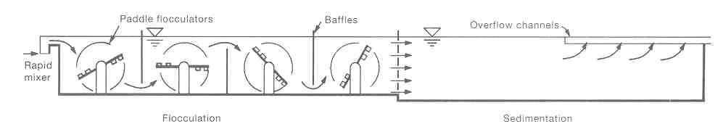
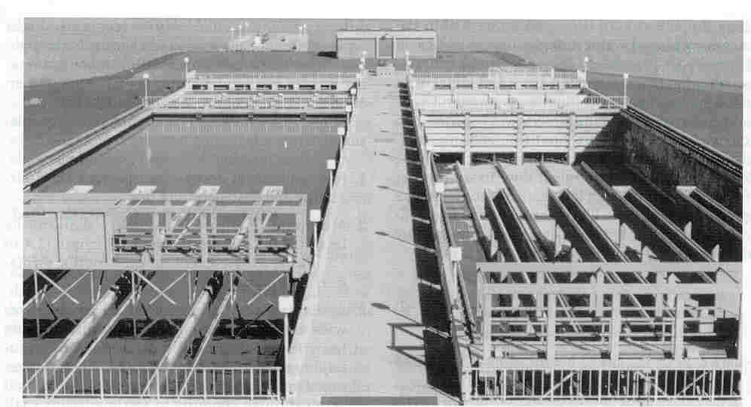
Settling (Sedimentation)

Slide 14
Settling Tanks, Basins, or Clarifiers
Generally, two types of sedimentation basins (also called tanks, or clarifiers) are used:
Rectangular and
Circular.
Rectangular settling, basins or clarifiers, are basins that are rectangular in plans and cross sections. In plan, the length may vary from two to four times the width.
The length may also vary from ten to 20 times the depth. The depth of the basin may vary from 2 to 6 m. The influent is introduced at one end and allowed to flow through the length of the clarifier toward the other end.

