Slide 1
Lubrication

Slide 2
Lubrication System
Functions
Reduces friction and wear between moving parts
Transfers heat away from engine parts
Cleans the inside of the engine
Cuts power loss and increases fuel economy
Absorbs shock between moving parts

Slide 3
Lubrication System
Operation
Components:
  engine oil
  oil pan
  pressure relief valve
  oil filter
  oil galleries

Slide 4
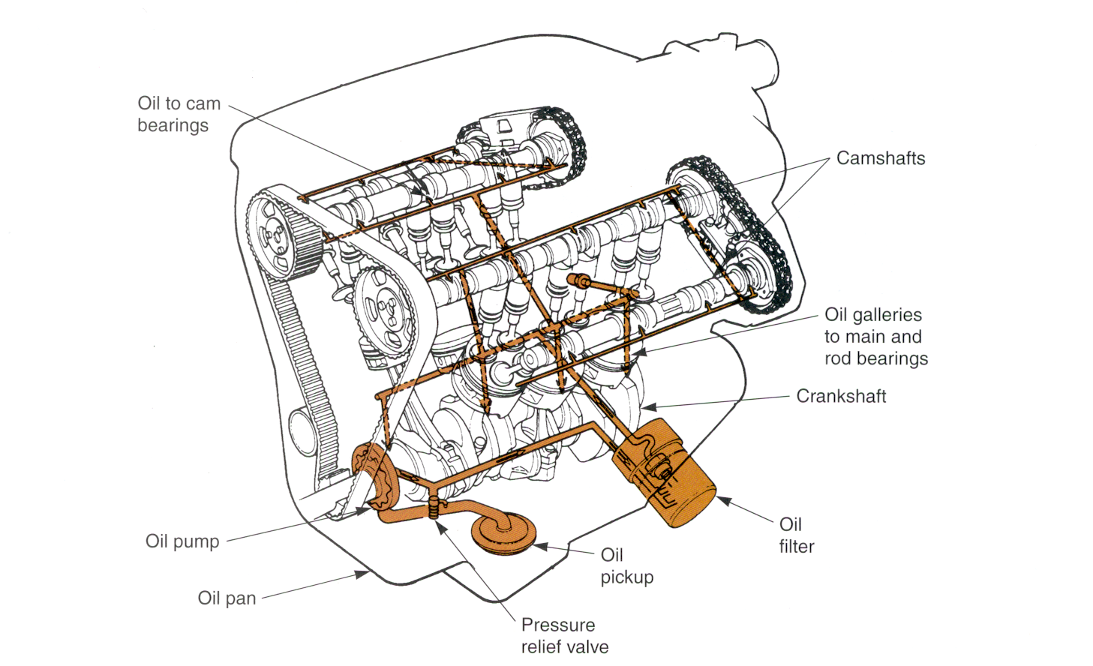
Typical Lubrication System

Slide 5
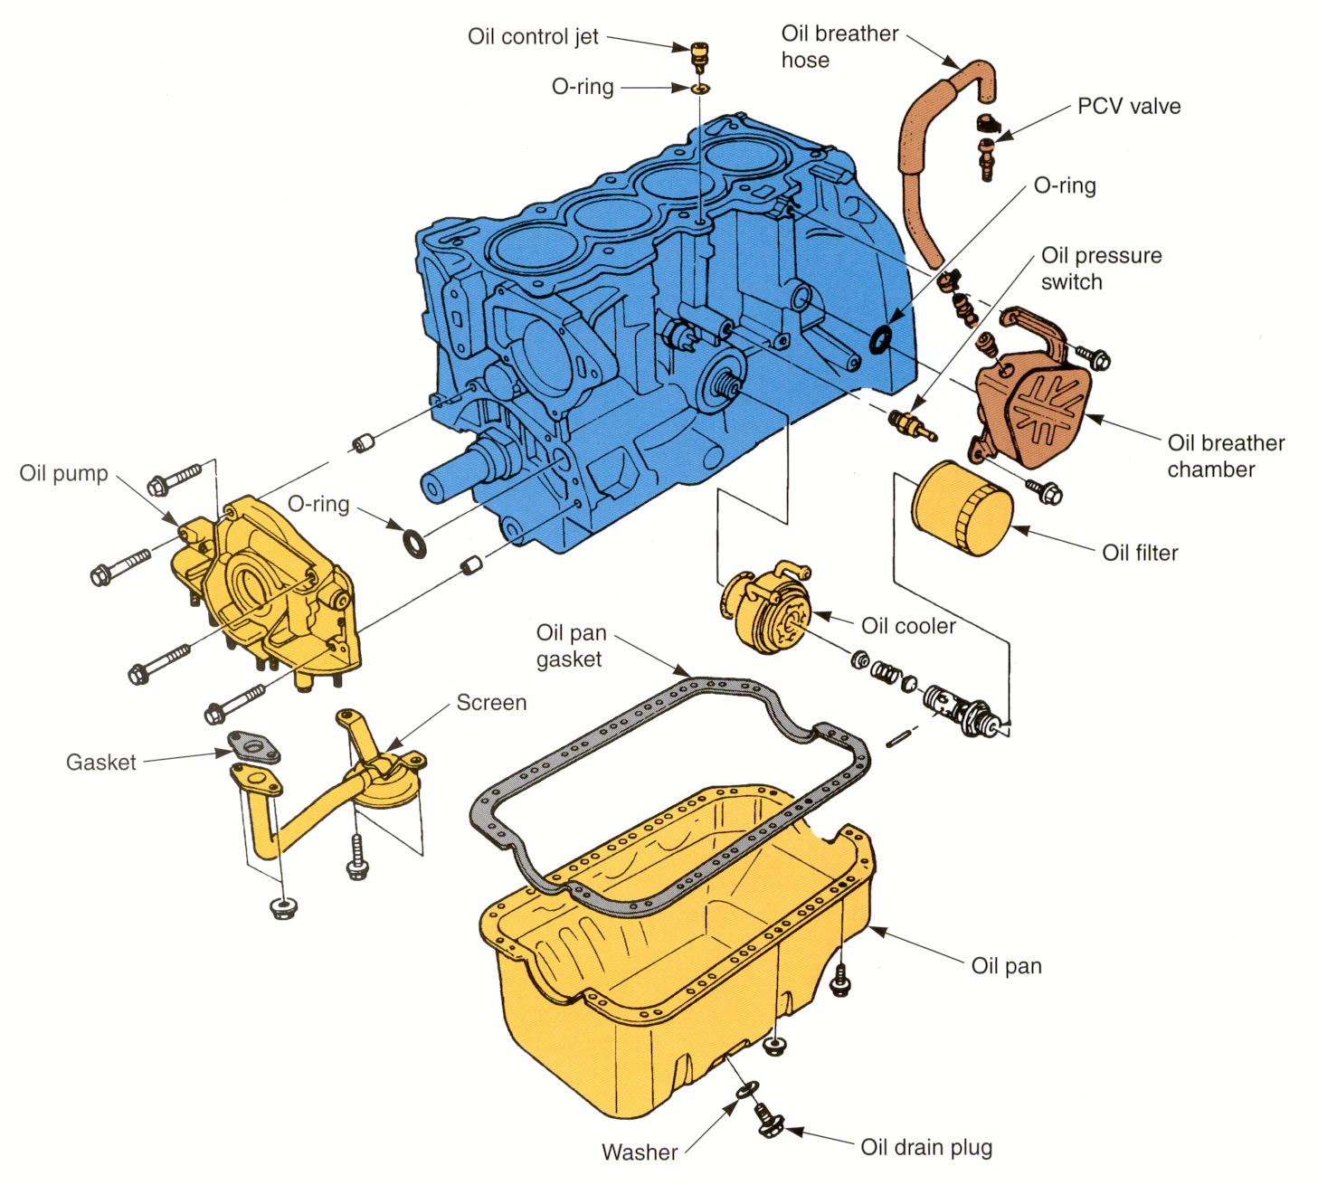
System Components

Slide 6
Operation
Oil pump pulls oil out of the pan
Pickup screen removes large particles
Pump pushes oil through the oil filter and galleries
Oil filter removes very small particles
Filtered oil flows to camshaft, crankshaft, lifters, rocker arms and other moving parts

Slide 7
Engine Oil
Keeps moving parts from making direct contact
Reduces friction
Refined from petroleum (crude oil)
Synthetic oils are made from substances other than crude oil

Slide 8
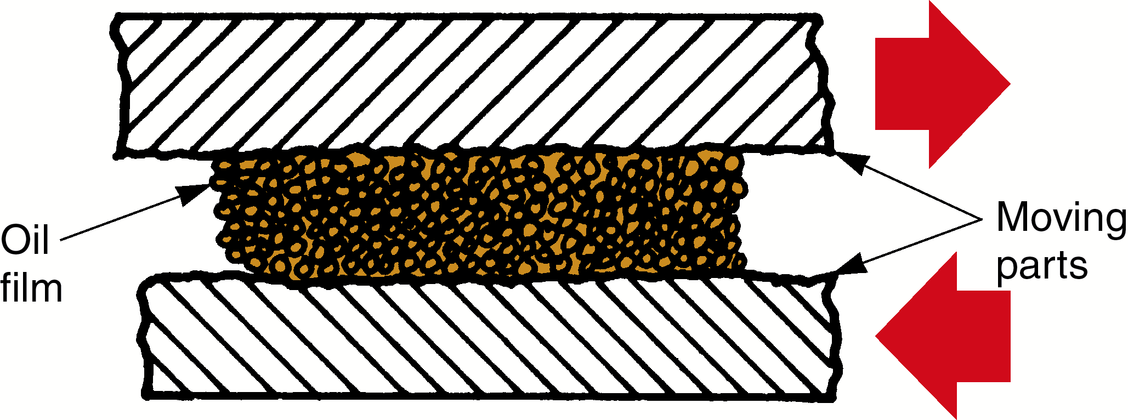
Oil Film
Oil film separates engine parts, preventing metal-on-metal contact

Slide 9
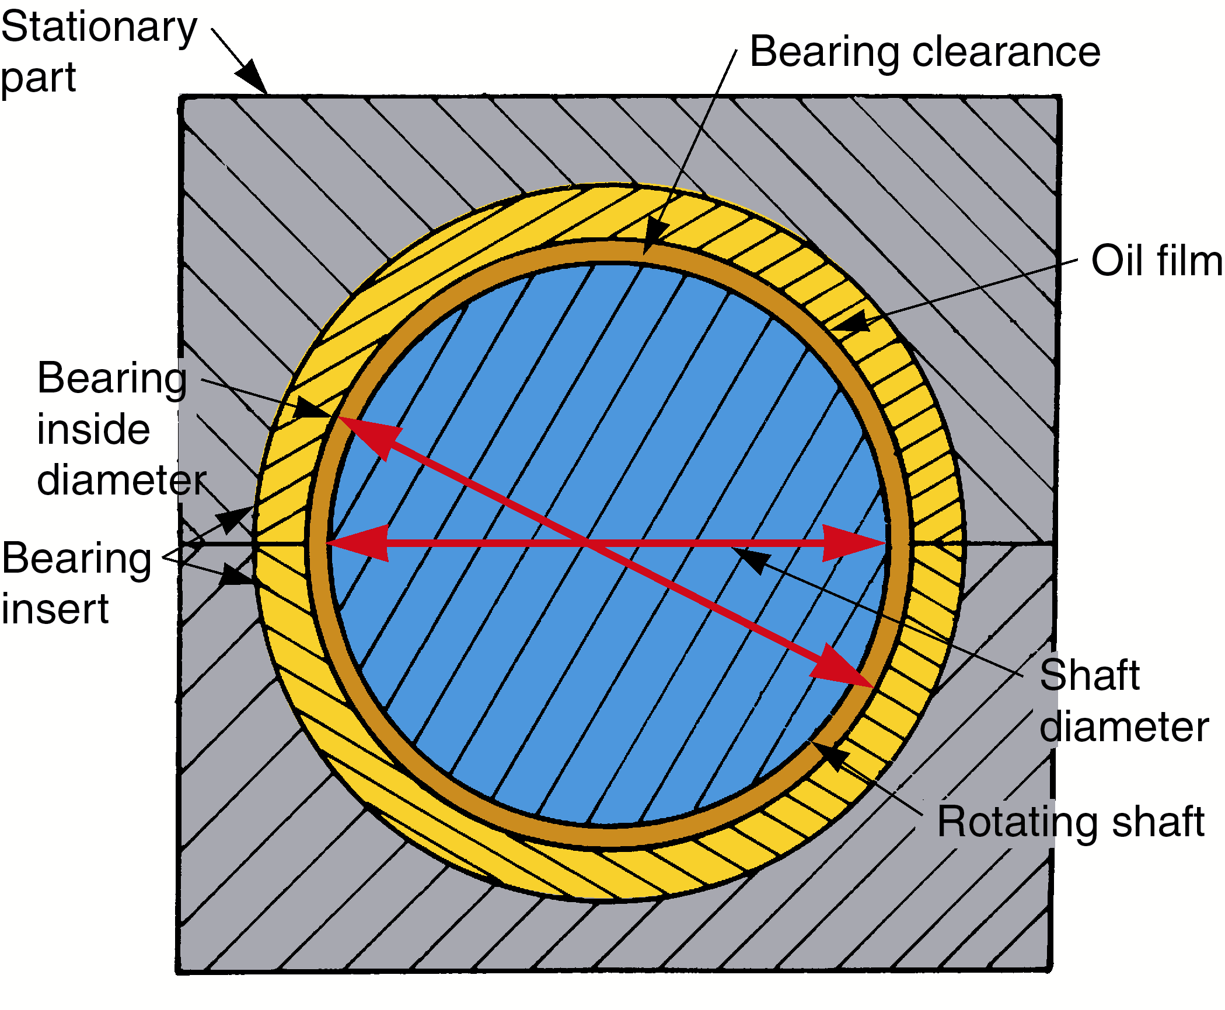
Oil (Bearing) Clearance
Small space between moving parts,
about .002” (0.05 mm)

Slide 10
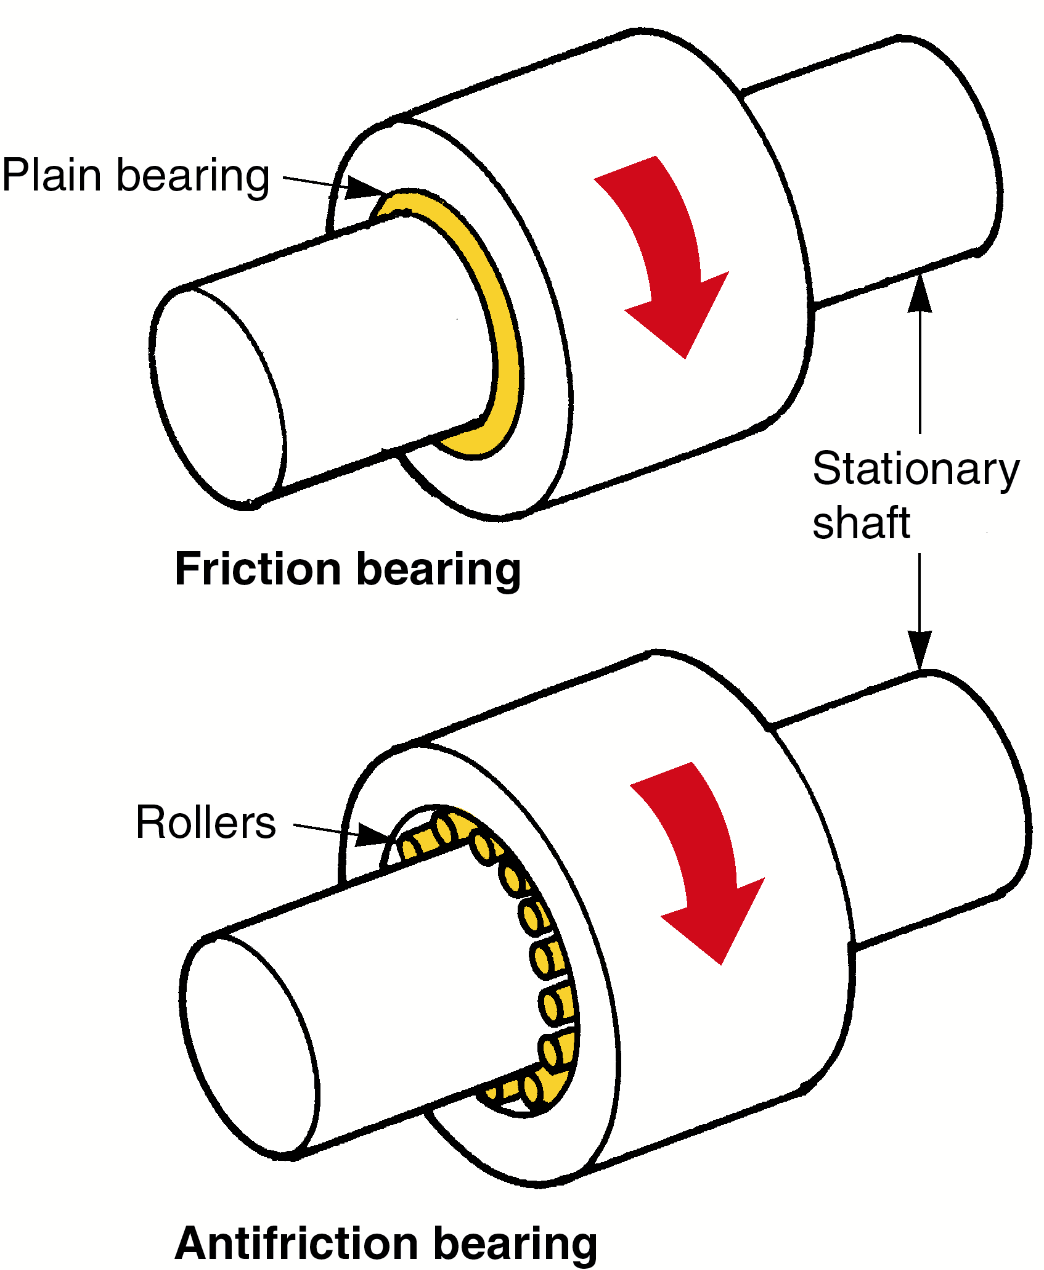
Bearing Types

Slide 11
Oil Viscosity (Weight)
Thickness or fluidity of engine oil
High viscosity number - SAE 30
  thick oil
Low viscosity number - SAE 5
  thin oil
Viscosity number is printed on container (standardized by SAE)

Slide 12
Temperature Effects
Cold oil is very thick and resists flow
When heated, oil thins and becomes runny
If it becomes too hot and thin, the oil film can break down and part contact can result

Slide 13
Single and
Multiviscosity Oils
Single viscosity—SAE 20, 30 or 40
  limited range of operating temperatures
  not as stable as multiviscosity oil
Multiviscosity—SAE 10W-30, 20W-50
  exhibits characteristics of a thin light oil when cold and a thicker, heavy oil when hot

Slide 14
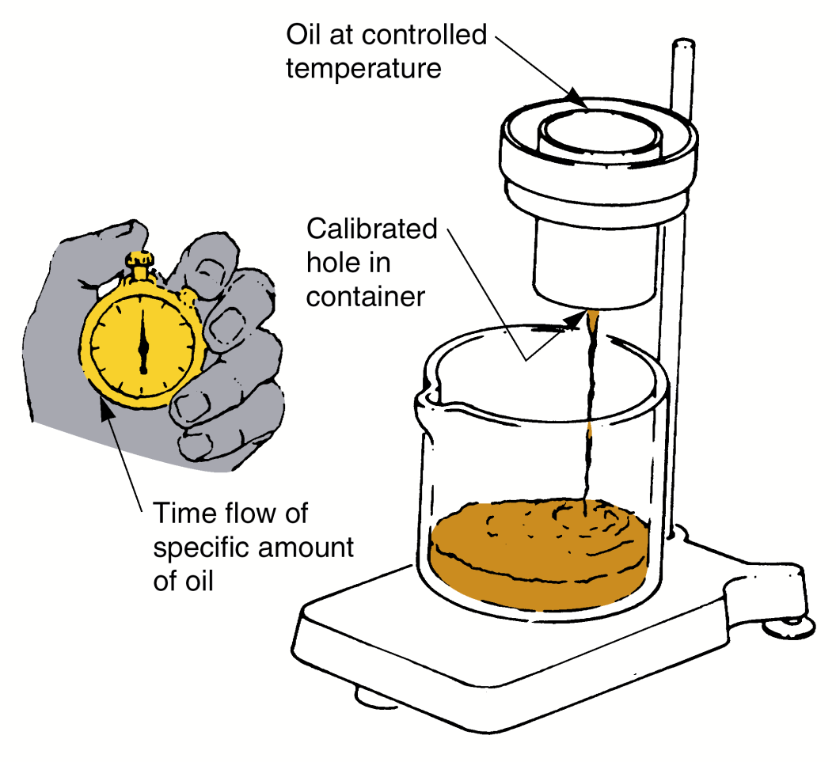
Oil Viscosity Rating
Determined by measuring how long oil takes to flow through a specific opening at a specific temperature

Slide 15
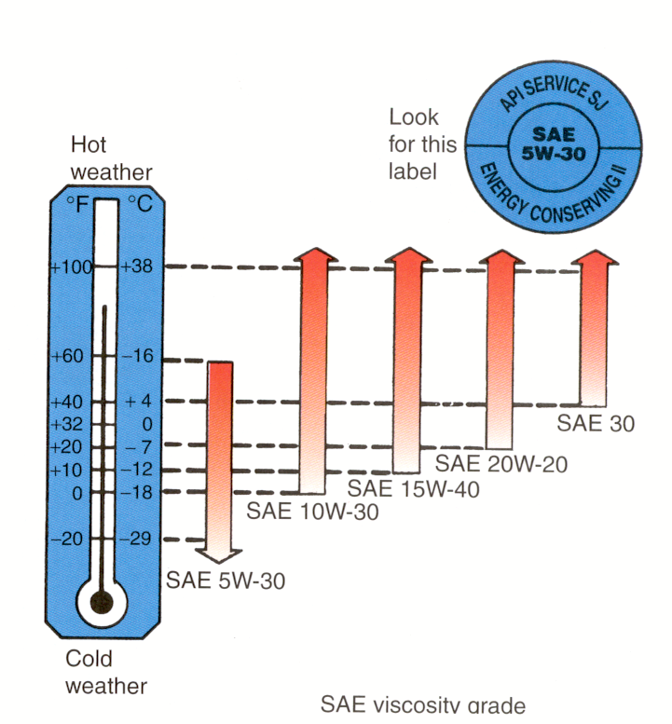
Selecting Oil Viscosity

Slide 16
Engine Oiling Methods
Pressure-fed oiling
  oil is provided by the oil pump to the crankshaft bearings, camshaft bearings, lifters and rocker arms
Splash oiling
  oil sprays out and on moving parts
  used between parts with moderate load such as piston rings, cylinders, and camshaft lobes

Slide 17
Full-Flow Lubrication
System forces all of the oil through the oil filter before the oil reaches the engine
Most common type in automotive systems
Bypass Lubrication
Does not filter all of the oil
Filters some of the extra oil not needed by the bearings
Not very common

Slide 18
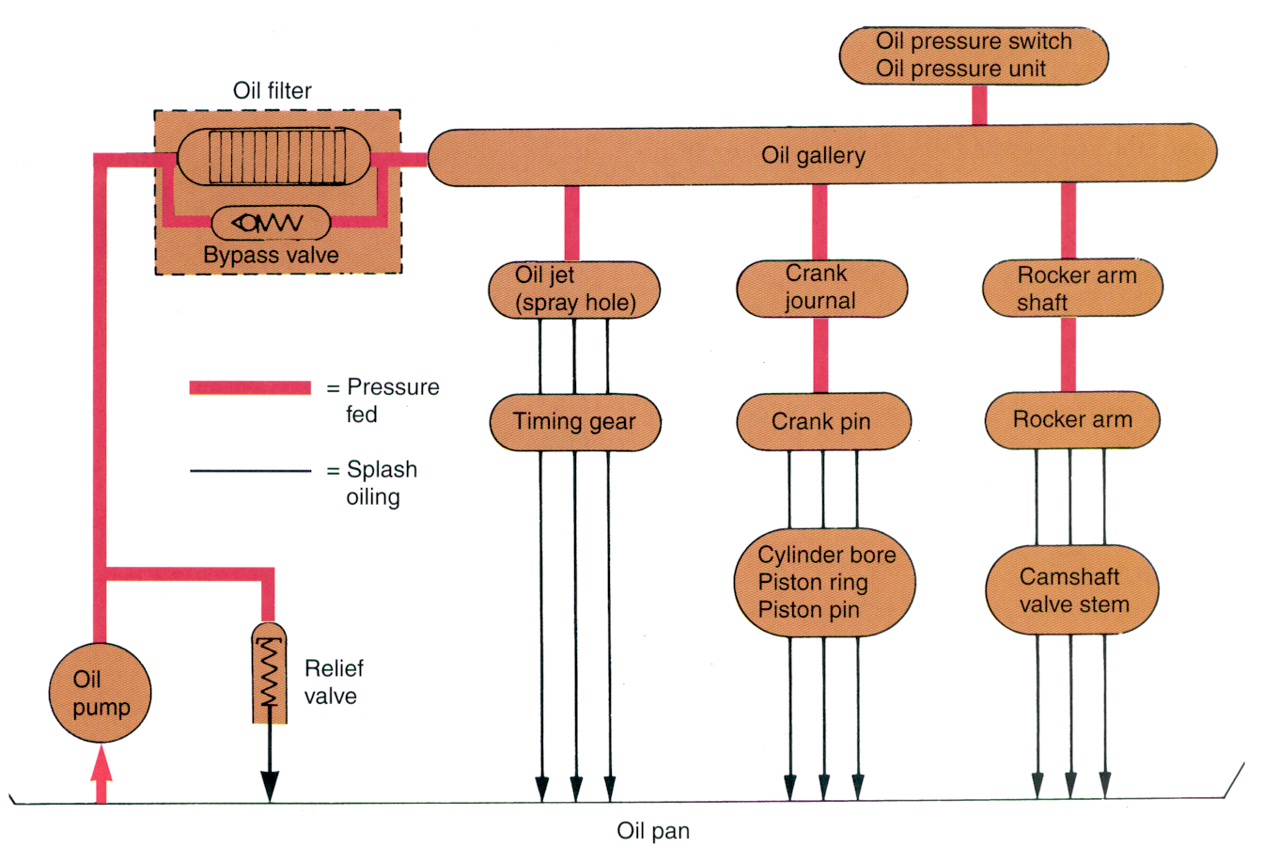
Full Flow System

Slide 19
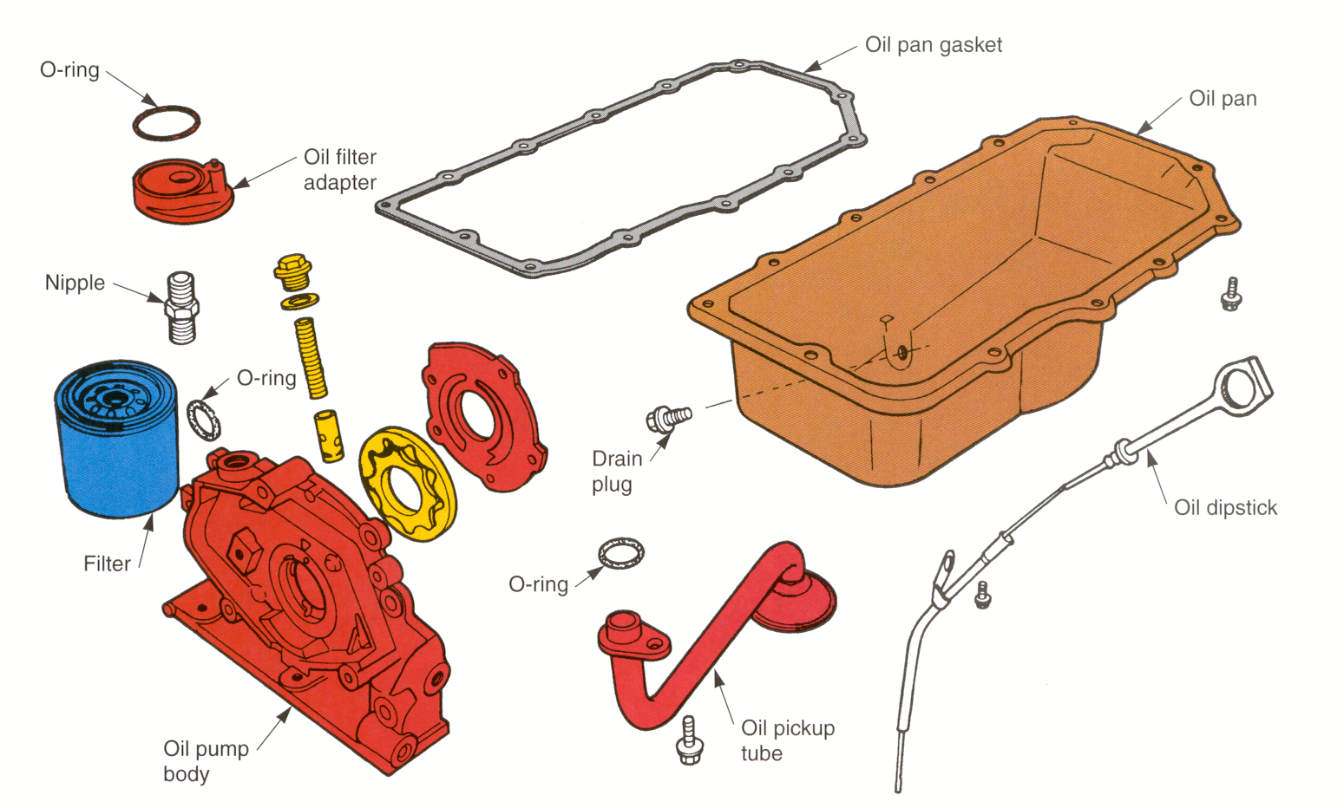
Oil Pan and Pump

Slide 20
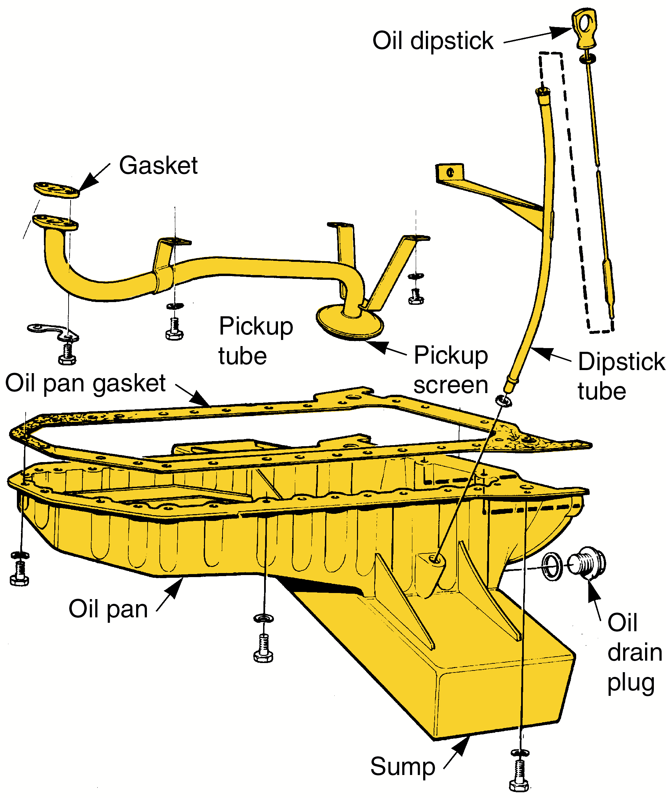
Oil Pan
Oil pan forms the sump at the bottom

Slide 21
Oil Pump
Forces oil out of the pan, through the filter and galleries, and to the engine bearings
Oil pump drives:
  shaft-driven
  belt-driven
  gear-driven
  crankshaft-driven

Slide 22
Pressure Relief Valve
Limits maximum oil pressure
Spring-loaded bypass valve in the oil pump, engine block or filter housing
Under normal pressure conditions, a spring holds the valve closed
Under high oil pressure conditions, the valve opens, allowing some oil to pour back into the oil pan

Slide 23
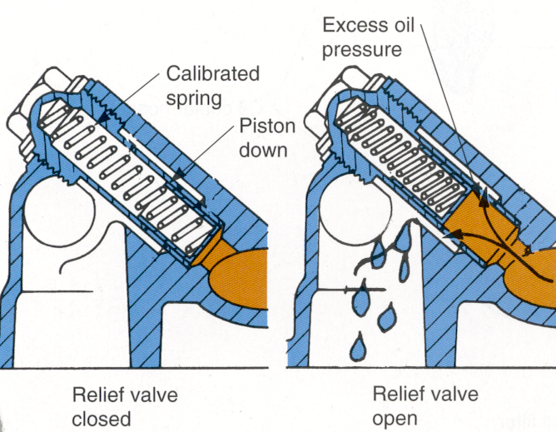
Pressure Relief Valve

Slide 24
Oil Filters
Removes small metal particles, carbon, rust and dirt from oil
Filter element
  paper or cotton filtering substance
Filter bypass valve
  protects the engine from oil starvation
  valve opens if too much pressure is formed in the filter
  allows unfiltered oil to the bearings

Slide 25
Oil Filter Types
Spin-on filter
  sealed unit
  filter is screwed into place
Cartridge oil filter
  separate element and housing
  to service, housing is removed
  new element is installed inside the existing housing

Slide 26
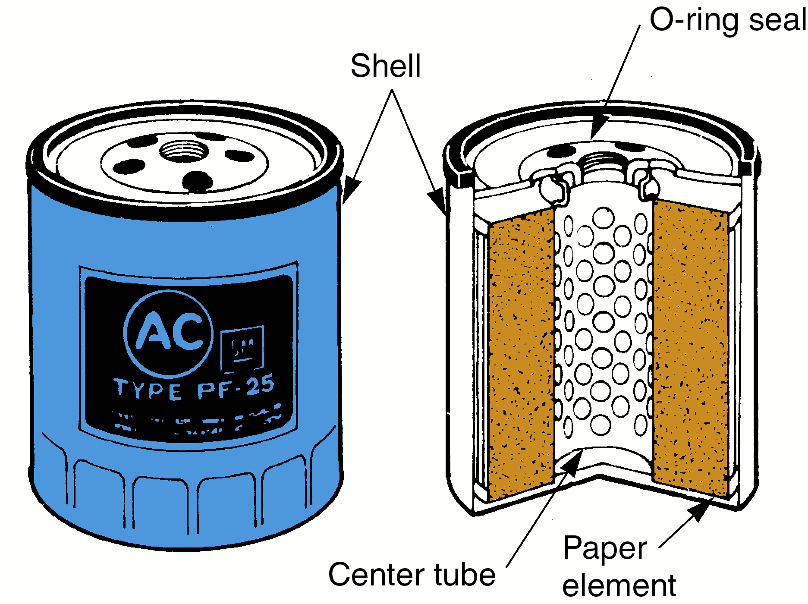
Spin-On Oil Filter

Slide 27
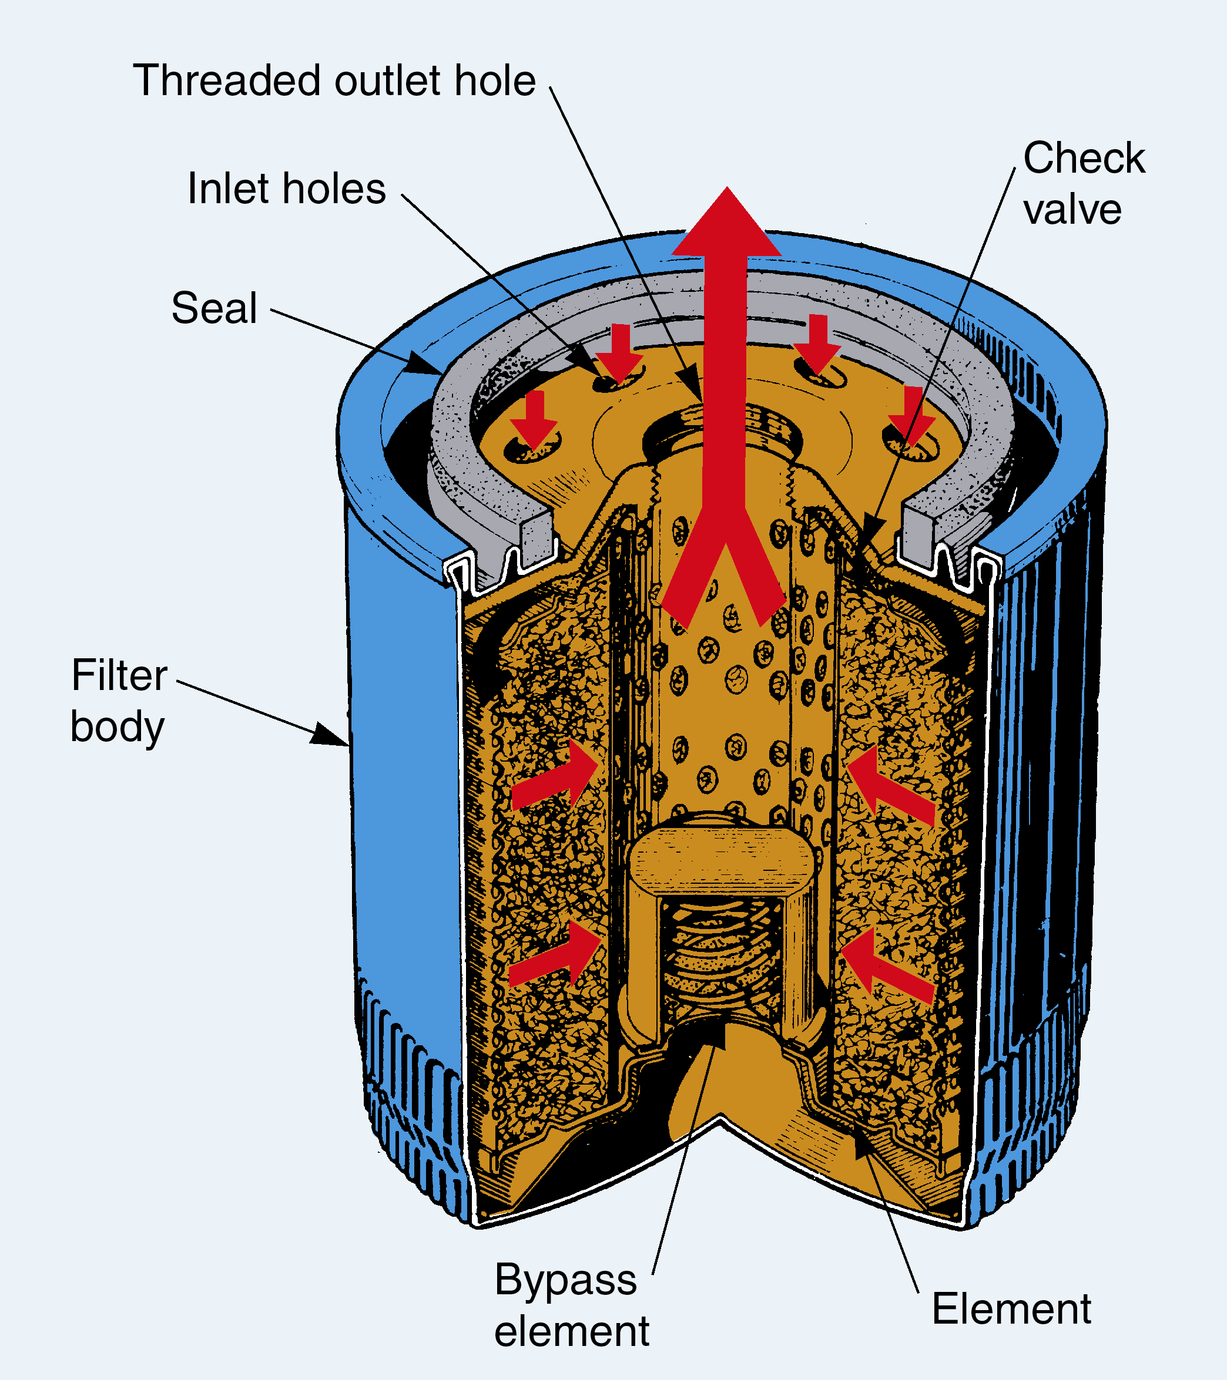
Filter Oil Flow

Slide 28
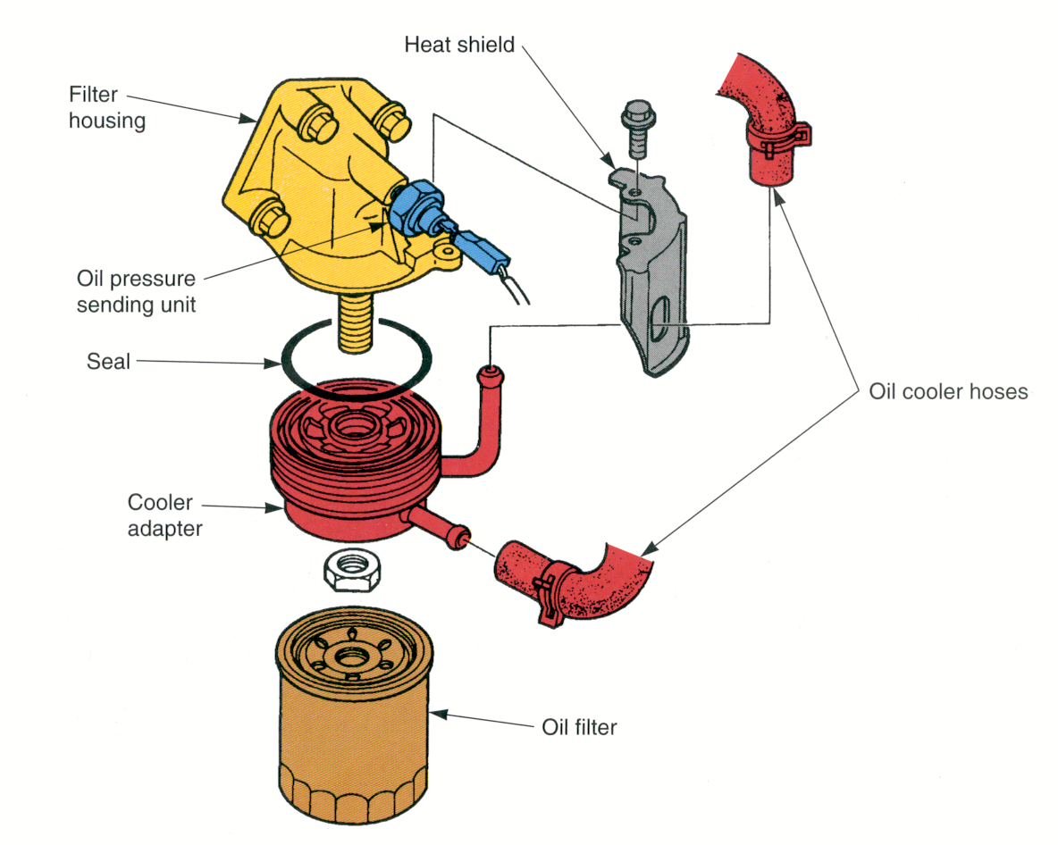
Oil Filter Housing
Mounting place for the oil filter

Slide 29
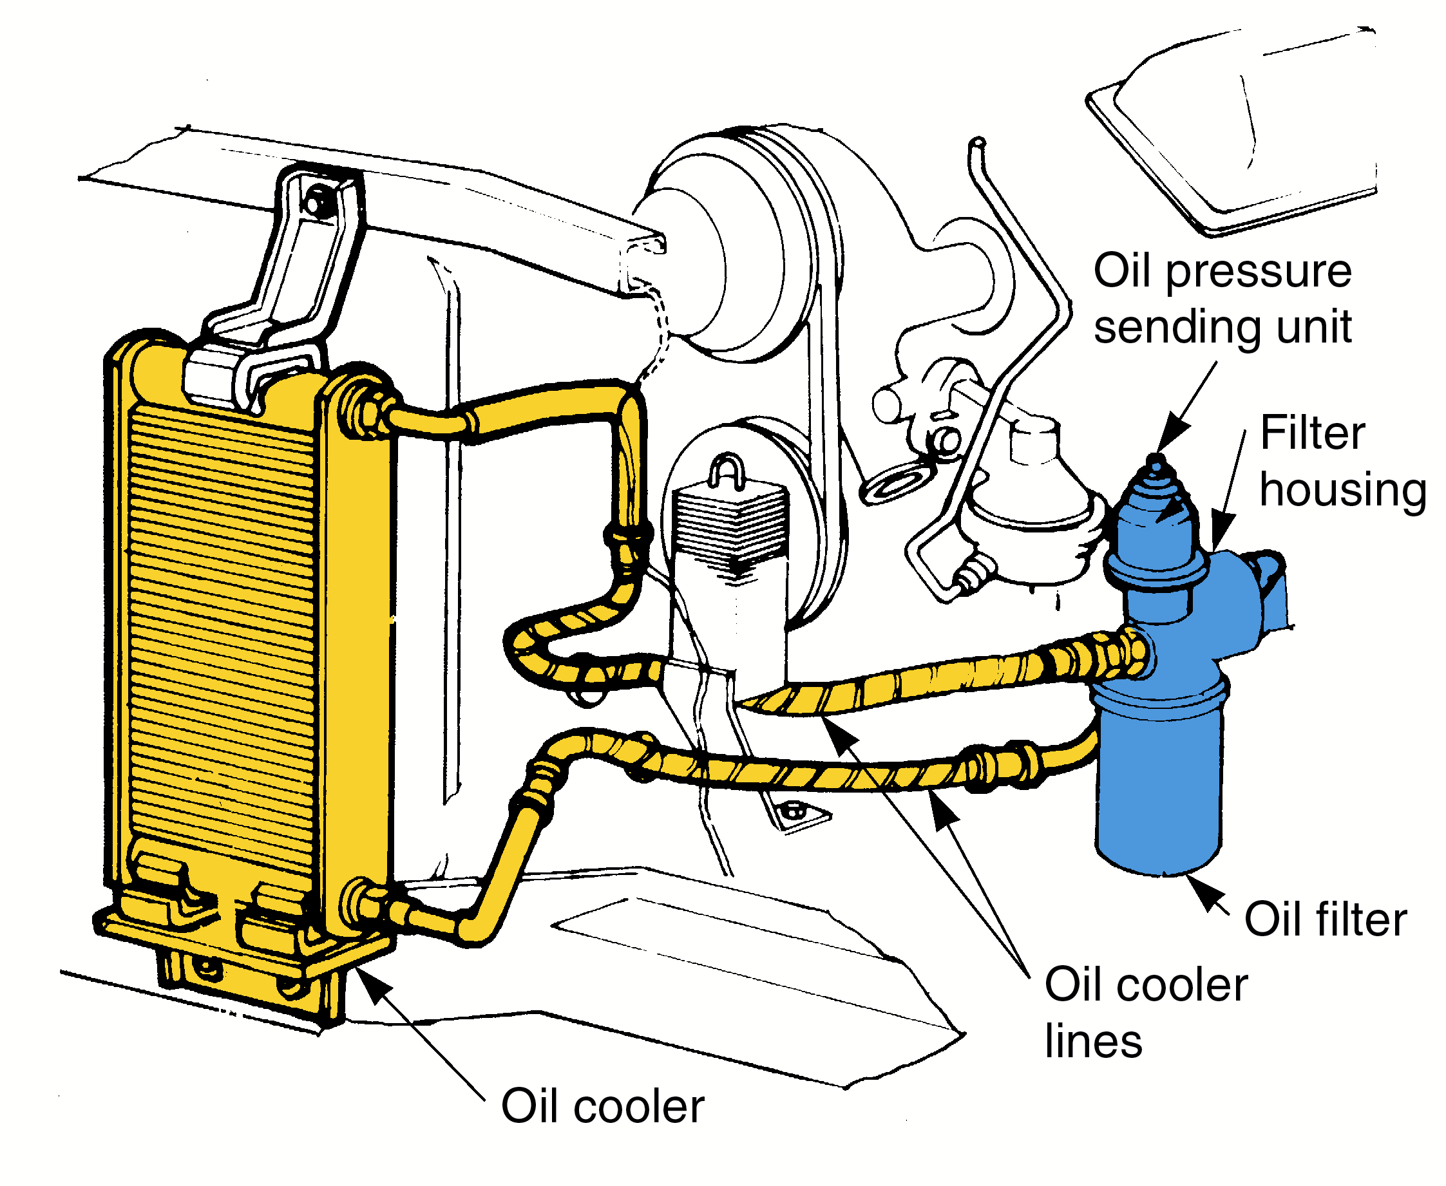
Oil Cooler
Heat exchanger to lower and control temperature of the engine oil

Slide 30
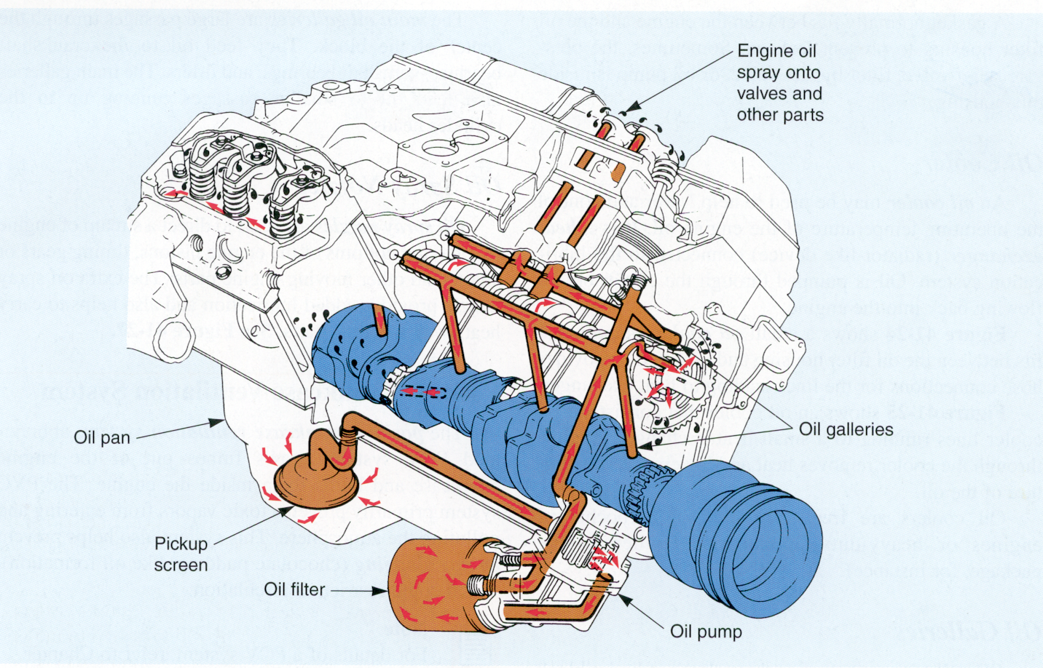
Oil Galleries
Passages through the cylinder block and head for lubricating oil

Slide 31
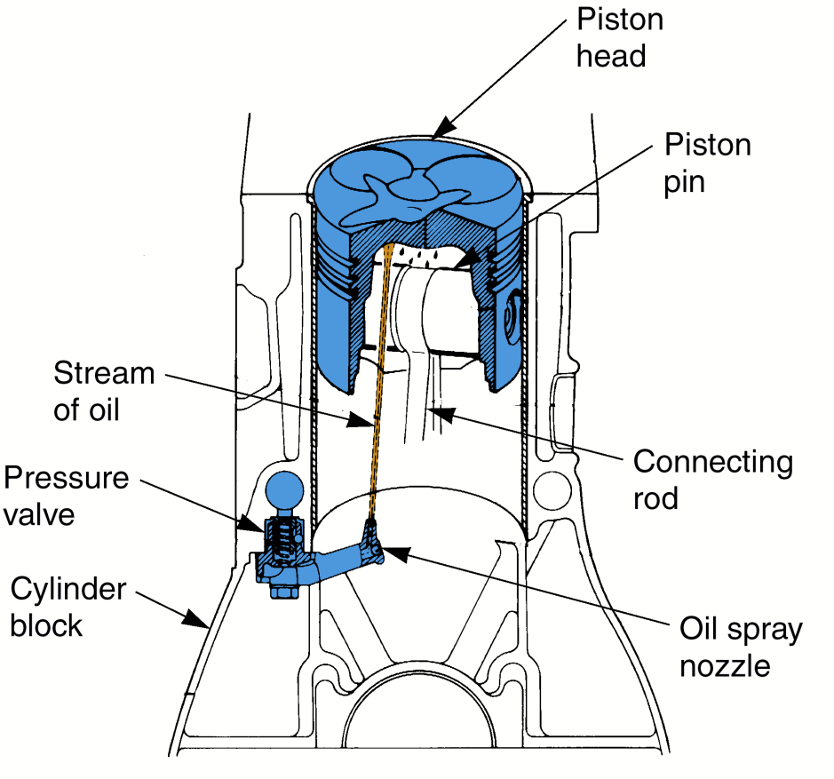
Oil Spray Nozzles
Direct a stream of oil onto the bottoms of the pistons, timing gears or chain
Fig 27

