Slide 1
MULTIPLE INTEGRALS
Changing the Order of Integration
The concept of changing the order of integration evolved to
help in handling typical integrals occurring in evaluation of
double integrals.
For example in the given double integral
we note that the choice of order of integration is wrong, as the inner integration cannot be performed. Hence we change the order of integration and try to integrate with respect to x first.
On changing the order of integration, the limits of integration change. To find the new limits, we draw the rough sketch of the region of integration. From the sketch, the limits of x and y should determined as usual.

Slide 2
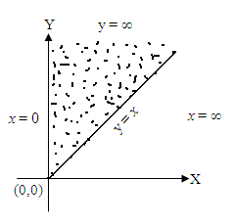
1. Evaluate by changing the order of integration in
Sol. Given y = x to y = ∞
and x = 0 to x = ∞

Slide 3
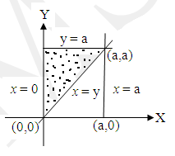
2. Evaluate by changing the order of integration in
Sol. Given y = x to y = a
and x = 0 to x = a

Slide 4
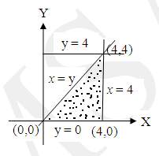
3. Evaluate by changing the order of integration in
Sol.

Slide 5
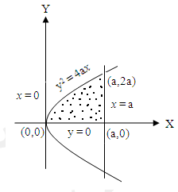
4. Evaluate by changing the order of integration in
Sol. Given y = 0 to y =
y² = 4ax and x = 0 to x = a

Slide 6
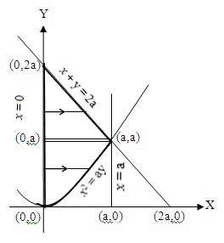
5. By changing the order of integration, evaluate
Sol. Given y = x²/a to y = 2a – x
(i.e.) ay = x² to x + y = 2a
and x = 0 to x = a

Slide 8
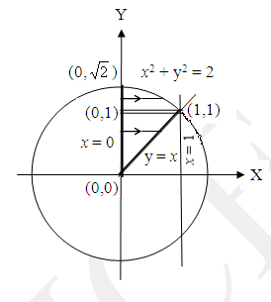
6. Evaluate by changing the order of integration in
Sol. Given y = x to y =
y² = 2 – x² (or) x² + y² = 2
and x = 0 to x = 1
Put x² + y² = t²
2x dx = 2t dt
x dx = t dt
x² + y² = t²
When x = 0, t² = y²
t = y
When x = y, t² = 2y²
t = y

Slide 9
Put x² + y² = t²
2x dx = 2t dt
x dx = t dt
x² + y² = t²
When x = 0, t² = y²
t = y
When x = , t² = 2 – y² + y²
t =

