Slide 1
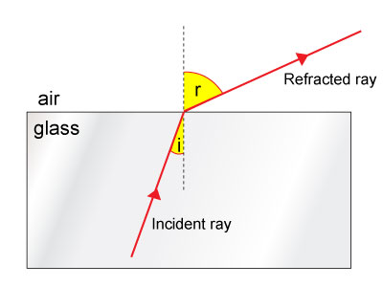
PRINCIPLE AND PROPAGATION OF LIGHT IN OPTICAL FIBER
In order to get total internal reflection :
The rays of light must travel from a dense medium to a less dense medium.
The angle of incidence must be greater than the critical angle.
1. Angle of incidence less than the critical angle
When the angle of incidence of the light ray leaving the glass is less than the critical angle, the light ray speeds up on leaving the glass and is refracted away from the normal.

Slide 2
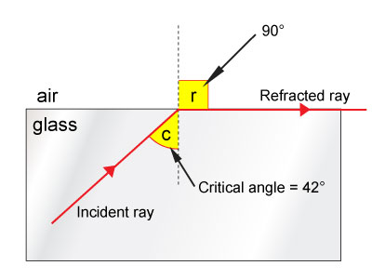
LIGHPRINCIPLE AND PROPAGATION OF T IN OPTICAL FIBER
2. Angle of incidence equal to the critical angle
When the angle of incidence of the light ray reaches the critical angle (42°) the angle of refraction is 90°. The refracted ray travels along the surface of the denser medium in this case the glass.

Slide 3
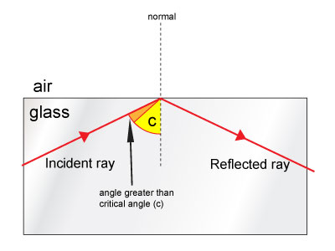
LIGHPRINCIPLE AND PROPAGATION OF T IN OPTICAL FIBER
3. Angle of incidence greater than the critical angle
When the angle of incidence of the light ray is greater than the critical angle then no refraction takes place. Instead, all the light is reflected back into the denser material in this case the glass. This is called total internal reflection.

Slide 4
TYPES OF OPTICAL FIBRES
Optical fibres are classified into three major types based on
(i) The material,
(ii) Number of modes and
(iii)Refractive index profile (or) Variation in the refractive index

Slide 5
CLASSIFICATION BASED ON MATERIALS BASED ON THE MATERIALS
optical fibres are classified into
(i) Glass fibres and
(ii) Plastic fibres.
Glass fibres
If the optical fibres are made from fusing mixtures of metal oxides and silicon glasses, they are known as glass fibres.
Examples: Core + Cladding
SiO2 + P2O3 – SiO2
GeO2 – SiO2 + SiO2
SiO2 + B2O3 – SiO2

Slide 6
CLASSIFICATION BASED ON MATERIALS BASED ON THE MATERIALS
(ii) Plastic fibres
If the optical fibres are made of plastics, they are called plastic fibres.
Examples: Core + Cladding
Polymethylmetha crylate + Co – polymer
Polystyrene + Methylmetha crylate
Advantages
➢ Plastic fibres are cheap
➢ They can be handled without any care due to their toughness and
durability.

Slide 7
CLASSIFICATION BASED ON NUMBER OF MODES
On the basis of the modes of propagation, optical fibres can be classified into two types.
They are,
(i) Single mode fibres and
(ii) Multimode fibres
Single mode fibres
In the single mode fibres, the diameter of the core is very small of the order of 5 to 10 μm.
So, it allows only one mode of propagation of light waves. Hence it is called as "single mode fibre".
That means light travels in this mode along a single path, that is along the axis.
The diameter of the cladding is very large of the order of 125 μm when compared with the diameter of the core.
Hence this type of fibre can be used for long distance communication.

Slide 8
CLASSIFICATION BASED ON NUMBER OF MODES
Multimode fibres
Here the diameter of the core is very large of the order of 50 to 350 μm when compared with the diameter of the core in single mode fibres.
So, it allows many modes of propagation of light waves. Hence it is called as "Multimode fibre".
The diameter of the cladding is also very large when compared with the diameter of the cladding in single mode fibres.
As a result, light travels in zig-zig paths. The numerical aperture of multimode fibre is larger as the core diameter is larger.
This is useful in short distance communication.

Slide 10
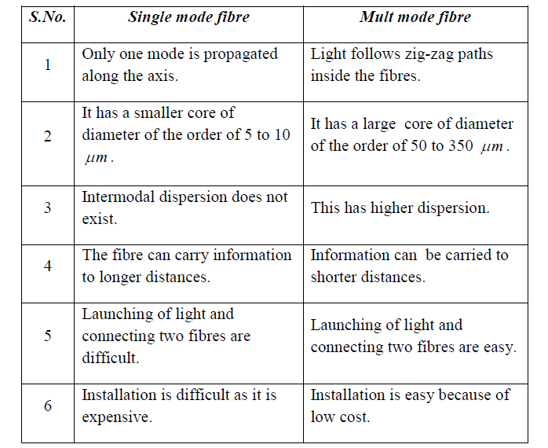
DIFFERENCES BETWEEN SINGLE MODE AND MULTIMODE FIBRES

Slide 11
CLASSIFICATION BASED ON REFRACTIVE INDEX
Based on the refractive indices of core and the cladding, optical fibers are classified into two types.
They are
(i) Step index fibre and
(ii) Graded index fibre.
Step index fibre
In the step index optical fibre the core has a uniform refractive index and the cladding has also a uniform refractive index . But n1 > n2. Let a and b be the radii of core and cladding respectively.
The refractive index changes abruptly at the core-cladding interface and the refractive index profile is in the shape of a step.
Hence, this fibre is called step index fibre. The refractive index profile of step index fibre is shown in Figure.

Slide 12
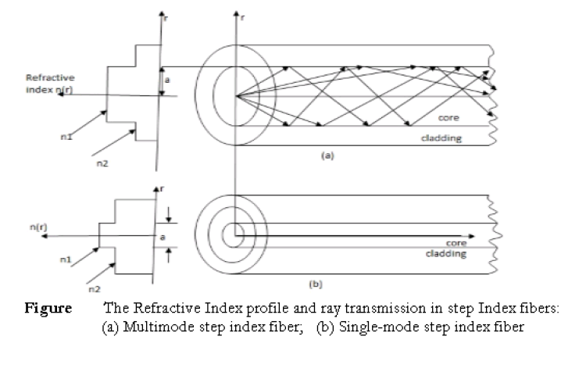
CLASSIFICATION BASED ON REFRACTIVE INDEX

Slide 13
CLASSIFICATION BASED ON REFRACTIVE INDEX
Graded index fibre
If the core has a non-uniform refractive index that gradually decreases from the centre towards the cor-cladding interface, the fibre is called graded index fibre.
The cladding has a uniform refractive index. The refractive index profile of graded index fibre is shown in Figure.
Applications
➢ It is widely used in intra-city trunks between central telephone offices.
➢ It is used in medium distance communications.
➢ It is used for communication in submarine cable system.

Slide 14
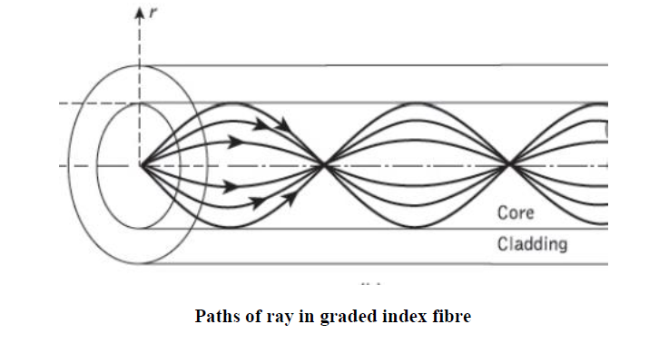
CLASSIFICATION BASED ON REFRACTIVE INDEX

Slide 15
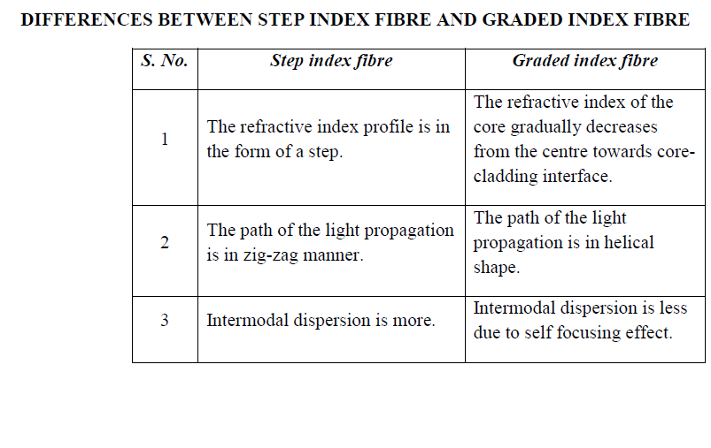

Slide 16
