Slide 1
Stoichiometry:
Theory of the proportions in which chemical species combine to with one another
Calculation of relative quantities of reactants and products in chemical reactions.s
Stoichiometric Equation:
It is the statement indicating relative moles of reactants and products that take part in the reaction . For example
CO + 2H₂ →CH₃OH
The above equation indicates that one molecule (mol or kmol ) of CO reacts with two molecules (mol or kmol ) of hydrogen to produce one molecule of (mol or kmol ) of methanol.

Slide 2
Stoichiometric Coefficient:
It is the number that precede the formula of each component involved in chemical reaction.
CO + 2H₂ →CH₃OH
In the above equation stiochiometry coefficient of H₂ is 2
Stoichiometric Ratio:
It is the ratio of stoichiometric coefficients of two molecular species/ components in the balanced reaction equation. Eg: CO + 2H₂ →CH₃OH stoichiometric ratio of H₂ to CO is 2/1 = 2
Stoichiometric Proportion :
Two reactants A and B are said to be present in the stoichiometric proportion if the ratio of moles of A present to the moles of B present is equal to the stoichiometric ratio obtained from the balanced reaction equation. Consider the following reaction

Slide 3
CO + 2H₂ →CH₃OH
For the reactants in the above reaction to be present in stoichiometric proportion, there must be 2 moles of H₂ for every mole of CO present in the feed to reactor.
Limiting Reactant :
The reactant that would disappear first if a reaction goes to completion is called the limiting reactant.
It is the one which decides the extent to which the reaction can proceed.
The limiting reactant is always present is less than its stoichiometric proportion relative to other reacting components.

Slide 4
Excess Reactant:
it is the one which is in excess of theoretical or stoichiometric requirement.
the excess component/reactants always found in a product stream through the reaction proceeds to completion.
C₂H₄ + ½ O₂ →C₂H₄O
In the production of ethylene oxide by oxidation of ethylene, oxygen/air fed to the reactor is always in excess of theoretically required. Thus ,ethylene is a limiting reactant and oxygen/air is a excess reactant.
Percent Excess:
Excess reactant involved in reaction is generally specified in terms of percent excess. It is the amount in excess of stoichiometric( theoretical) requirement of expressed as the percentage of stoichiometric/ theoretical

Slide 5
requirement. Consider a reaction
A + B →C where B is excess reactant, then
Percent Excess of B = [moles of B supplied or fed ---- moles of B theoretically
required]
------------------------------------ x 100
moles of B theoretically
required
Moles of B theoretically required are the moles of B that would correspond to stoichiometric proportions calculated based on limiting reactant charged.

Slide 6
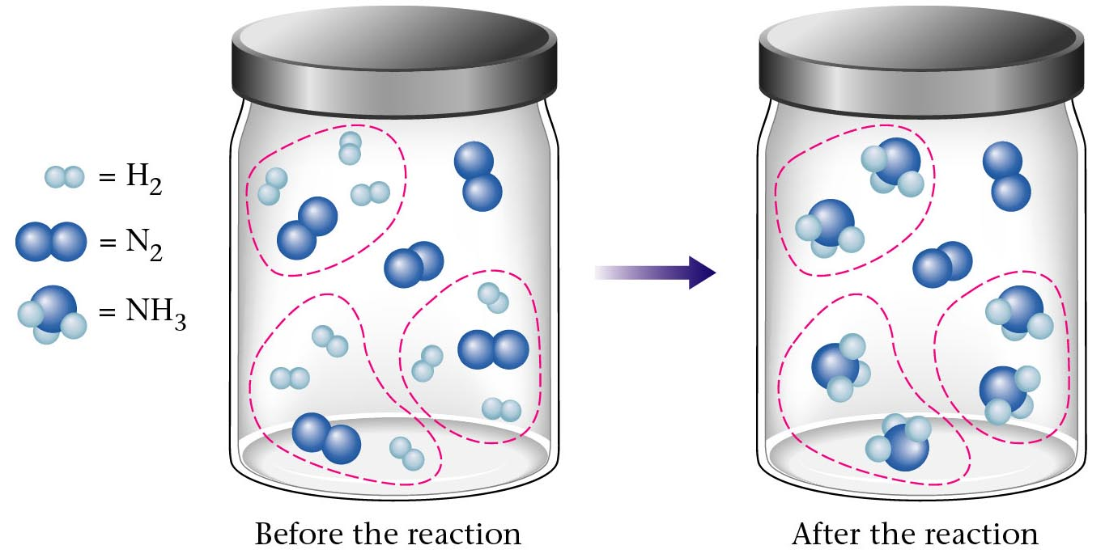
Before and After Reaction 2
N₂ + 3H₂ 2NH₃
excess
limiting
Before the reaction
After the reaction
LIMITING REACTANT DETERMINES AMOUNT OF PRODUCT

Slide 7
Conversion:
Based on limiting reactant and gives idea regarding degree of completion of reaction
unreacted quantities of raw materials are easily obtained knowing the charged quantities with the help of conversion
gives in case of unit process whether recycling is to be done or not for process to be economical.
consider the following reaction
N₂ + 3H₂ →2NH₃ where hydrogen is a limiting reactant and nitrogen is excess reactant.
conversion or fractional conversion of hydrogen is the ratio of amount of hydrogen reacted to the amount of hydrogen charged or fed to a reactor.

Slide 8
The percentage conversion of hydrogen is the amount of hydrogen reacted expressed as the percentage of amount of hydrogen fed or charged.
Amount of hydrogen can be expressed on mole or weight basis. If amount of hydrogen in moles
% conversion of hydrogen = moles of hydrogen reacted
------------------------------- x 100
moles of hydrogen fed or
charged
In case of recycle operation per pass conversion is commonly used.
Per pass is defined as the quantity of limiting reactant reacted/ consumed expressed as a percentage of limiting reactant in the mixed.

Slide 9
Yield and Selectivity:
In most of the chemical process the objective is to produce the desired product, the raw materials may also undergo a series of parallel reactions resulting in the formation of undesired product which has adverse effec on the economics of the process
In such cases the steps are taken to depress the side reactions by use of selective catalyst, addition of inhibitors in the feed, etc.
yield and selectivity are used in multiple reactions to give information about the degree to which a desired reaction predominates over side reaction involved.

Slide 10
Consider a series of reactions
A + B → C
C + B→ D
A →C → D
Or parallel reactions
A →C
A →D where C - desired product , D - undesired product and A- limiting reactant. Then yield of C is given as :
yield of C = moles of A reacted to produce C
---------------------------------------- x 100
moles of A totally reacted

Slide 11
For example methanol(CH₃OH) can be converted into ethylene ( C₂H₄ ) and Propylene by following reaction:
2CH₃OH → C₂H₄ + 2H₂O
3CH₃OH → C₃H₆ + 3H₂O
If ethylene is the desired product, then yield is given as
yield of ethylene = moles of methanol reacted to produce
ethylene
---------------------------------------- x 100
moles of methanol totally reacted

Slide 12
Consider a parallel reactions
A →C
A →D where C - desired product , D - undesired product and A- limiting reactant. Then selectivity is given as :
Selectivity of C relative to D =
moles of C (desired product) formed
-----------------------------------------------
moles of D ( undesired product) formed

Slide 13
. For example methanol(CH₃OH) can be converted into ethylene ( C₂H₄ ) and Propylene by following reaction:
2CH₃OH → C₂H₄ + 2H₂O
3CH₃OH → C₃H₆ + 3H₂O
If ethylene is the desired product, Then selectivity is given as :
Selectivity = moles of ethylene formed
-----------------------------------------------
moles of propylene formed

