Slide 1
JCT College of Engineering & Technology, Pichanur,Coimbatore-641105.
Microprocessor & Microcontroller
Faculty Name : P.Sam Jasper
Designation : Assistant Professor
Year/Sem : III/V
Dept : EEE

Slide 2
Overview
Basic components of digital computers
Microcontrollers and Embedded Systems
Applications and Common Microcontrollers
MSP430 Family of Microcontrollers
On-chip memory, registers
On-chip facilities overview

Slide 3
Basic Components of Digital Computer
CPU
Memory
I/O
Memory
CPU
I/O
Could be a chip, a board, or several boards

Slide 4
Microcontrollers
Memory
CPU
ROM RAM
I/O
Subsystems:
Timers, Counters, Analog
Interfaces, I/O interfaces
A single chip

Slide 5
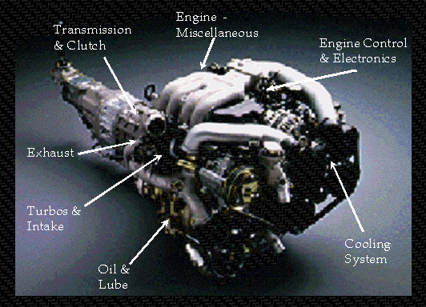
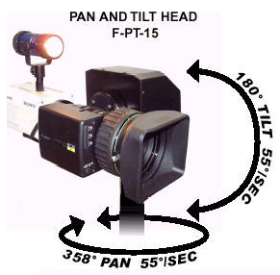
Embedded Systems

Slide 6
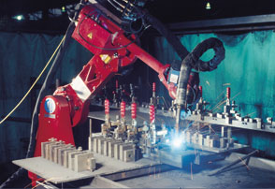
Real Time Control
Must be able to respond
predictably and in a known amount of time
Environment cannot wait for microcontroller to respond.

Slide 7
Embedded System
General Block Diagram
sensor
Microcontroller
(uC)
actuator
Sensor conditioning
Output interfaces
sensor
indicator
sensor

Slide 8
Common Microcontrollers
Atmel
ARM
Intel
  8-bit
    8XC42
    MCS48
    MCS51
    8xC251
  16-bit
    MCS96
    MXS296
National Semiconductor
  COP8
Microchip
  12-bit instruction PIC
  14-bit instruction PIC
    PIC16F84
  16-bit instruction PIC
NEC
Motorola
  8-bit
    68HC05
    68HC08
    68HC11
  16-bit
    68HC12
    68HC16
  32-bit
    683xx
Texas Instruments
  TMS370, 16/32 bit
  MSP430 , 16 bit
Zilog
  Z8
  Z86E02

Slide 9
Microcontroller Architectures
Memory
Address Bus
0
Program + Data
CPU
Von Neumann
Architecture
Data Bus
2^{n}
Memory
Address Bus
0
Program
Fetch Bus
Harvard
Architecture
CPU
Address Bus
0
Data
Data Bus

Slide 10
MCS-51 “Family” of Microcontollers
8051 introduced by Intel in late 1970s
Now produced by many companies in many variations
The most pupular microcontroller – about 40% of market share
8-bit microcontroller

Slide 11
“Original” 8051 Microcontroller
Oscillator and timing
4096 Bytes Program Memory
128 Bytes Data Memory
Two 16 Bit Timer/Event Counters
8051 CPU
Internal data bus
64 K Byte Bus Expansion Control
Programmable I/O
Programmable Serial Port Full Duplex UART Synchronous Shifter
subsystem interrupts
External interrupts
Control
Parallel ports
Address Data Bus
I/O pins
Serial Output
Serial Input
Notes:
Program memory – RAM or ROM?
Data memory – RAM or ROM?

Slide 12
Review Binary/Hexidecimal
Decimal | Binary | Hexidecimal
0 | 0000 | 0
1 | 0001 | 1
2 | 0010 | 2
3 | 0011 | 3
4 | 0100 | 4
5 | 0101 | 5
6 | 0110 | 6
7 | 0111 | 7
8 | 1000 | 8
9 | 1001 | 9
10 | 1010 | A
11 | 1011 | B
12 | 1100 | C
13 | 1101 | D
14 | 1110 | E
15 | 1111 | F
Conversions:
1000 1110 (binary)
8 E (hex)
Notations for hex:
0x8E
8Eh
8E₁₆

Slide 13
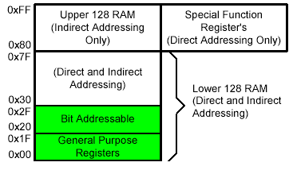
On-Chip DATA Memory: RAM
Internal RAM

Slide 14
Registers
1F
18
Four Register Banks
Each bank has R0-R7
Bank 3
17
10
Bank 2
0F
08
Bank 1
07
06
05
04
03
02
01
00
R7
R6
R5
R4
R3
R2
R1
R0
Bank 0

Slide 15
Bit Addressable Memory
2F
2E
2D
2C
2B
2A
29
28
7F |  |  |  |  |  |  | 78
 |  |  |  |  | 1A
 |  |  |  |  |  |  | 10
0F |  |  |  |  |  |  | 08
07 | 06 | 05 | 04 | 03 | 02 | 01 | 00
20h – 2Fh (16 locations X 8-bits = 128 bits)
Bit addressing:
mov C, 1Ah
or
mov C, 23h.2
27
26
25
24
23
22
21
20

Slide 16
Special Function Registers
DATA registers
CONTROL registers
Timers
Serial ports
Interrupt system
Analog to Digital converter
Digital to Analog converter
Etc.
Addresses 80h – FFh
Direct Addressing used to access SPRs

Slide 17
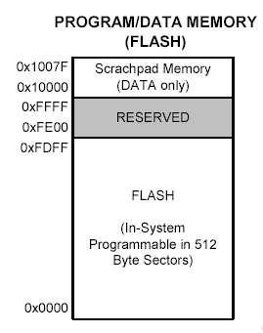
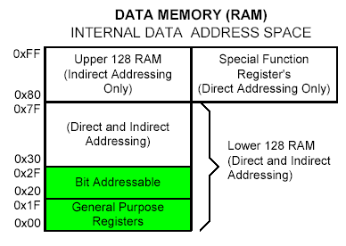
On-Chip Memory: Program/Data

Slide 18
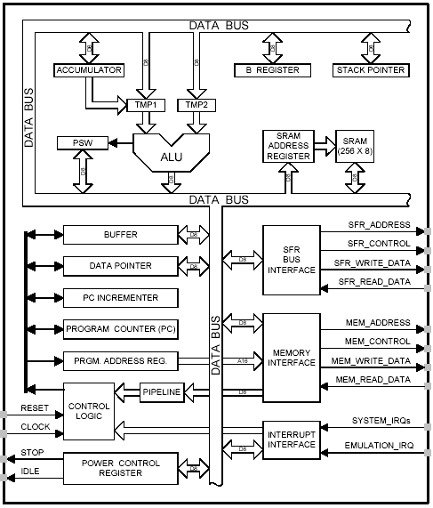
8051 CPU Registers
A (Accumulator)
B
PSW (Program Status Word)
SP (Stack Pointer)
PC (Program Counter)
DPTR (Data Pointer)
Used in assembler instructions

Slide 19
On-Chip Facilities Overview
(Original 8051)
Parallel Input/Output Ports
System Clock Generator
Serial Port
Timers
Interrupt Control

Slide 20
Parallel I/O Ports
Each port can be input or output
Direction is set in Special Function Registers
Port0
latch
Port1
latch
Port2
latch
Port3
latch
Port0
Port1
Port2
Port3

Slide 21

System Clock Generator
External crystal oscillator
Input
circuit
sysclk
8051
Original 8051 uses 12 sysclk cycles per “machine cycle”

Slide 22
Serial Port (UART)
Original 8051 had one serial port
TX (transmit)
Serial
Port
RX (receive)
Data sent and received serially
BAUD rate must agree between sender and receiver
Transmission modes selected using SFR

Slide 23
Internal Timers
Original 8051 has 2 timers
16 bits
16 bits
TH0 : TL0
TH1 : TL1
Timer 0
Timer 1
Timers increment on each system clock
Timer registers (TH0, TL0, TH1, TL1) can be read or written to
Timer overflow can cause “interrupts” or set SFR bits high

Slide 24
Interrupt Control
…
mov a, #2
mov b, #16
mul ab
mov R0, a
mov R1, b
mov a, #12
mov b, #20
mul ab
add a, R0
mov R0, a
mov a, R1
addc a, b
mov R1, a
end
interrupt
ISR: orl P1MDIN, #40h
orl P1MDOUT,#40h
cpl P1.6
reti
Program Execution
return

Slide 25
Interrupt Control
Original 8051 has five sources of interrupts
  Timer 1 overflow
  Timer 2 overflow
  External Interrupt 0
  External Interrupt 1
  Serial Port events (buffer full, buffee empty, etc)
Interrupts enabled and disabled using SFR

